Slide 1
THE NEXT BAKERY
Capstone Project
Carlos Gonzalez Romero

Slide 2
INDEX
Introduction & Business Problem
Data
Methodology
Result & Discussion
Conclusion

Slide 3
Introduction
&
Business Problem

Slide 4
Introduction & Business Problem
The Levaduramadre brand is a gourmet bakery that is in full expansion in the city of Madrid, Spain. This expansion is happened mainly in the center and north-center of Madrid.
To make the expansion in a homogeneus way, the Levaduramadre owner ask us to find an optimal location for a new bakery of the brand Levaduramadre in the south-center of Madrid.
To do this, we will assume that the bakery owner gives us a choice of 3 specific locations.

Slide 5
Data

Slide 6
Data
Data Sources
For this work we will use the data obtained from Foursquare API. Although it will be the same API, we will obtain three datasets:
First dataset will contain information about all Levaduramadre (existings and possibles future): This dataset will be used to obtain the second dataset.
Second dataset will contain information about the venues around all Levaduramadre: This dataset will be used to create a cluster (using k-means clustering) of Levaduramadre’s locations to get the first criteria.
Third dataset will contain information about the bakeries around the possible locations: This dataset will be used to get the second criteria.

Slide 7
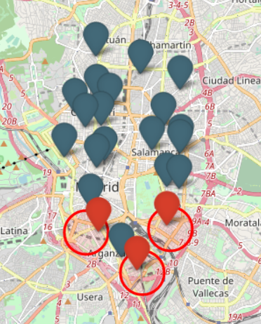
Data
Data Assumption
As said before, we assumed that Levaduramadre owner gives us 3 locations to choice the best option to open a new Levaduramadre.
Those locations are selected in three zones in the south-center of Madrid without Levaduramadre, and the coordinates of the possibles future Levaduramadre are:

Slide 8
Data
Data Used
After clean the data, we get the next datasets to develop this project:
Second dataset
Third dataset

Slide 9
Methodology

Slide 10
Methodology
In this project we will calculate two criteria to choose where is the best locations to open a new bakery of the Levaduramadre´s branch.
In first step we have collected and cleaned the required data and save it in two dataframes (called second and third dataset).
In the second step we use the datasets to develop the criteria:
The second dataset will be used to develop the first criterion, which consist in make a clustering of the neighborhoods with a Levaduramadre and the neighborhoods with the possibility to have one. We will make a clustering with 4 cluster and other with 5 cluster.
The third dataset will be used to develop the second criterion, which consist in make a serie of weighted average with the distances between the possibles future Levaduramadre and the bakeries around them in a 250 meters of ratio.
In the third step we develop an analysis of the criteria´s result and finally we will make a conclusion.

Slide 11
Methodology
First Criterion
The clustering will be made with the categories of the venues around the Levaduramadre, but to develop a good model we avoid the venues with the value 'NaN' in category, and only select the venues which the categories have a count upper or equal than 15.
Then grouping the datas by Levaduramadre (existing and possibles future), making the mean (normalized) about how many repetitions have a category for each Levaduramadre.
After obtain the data we develop two models of clustering, one with 4 cluster and other with 5 cluster.

Slide 12
Methodology
Second Criterion
How the Option_03 don´t have any bakery around (because there aren´t any data of Option_03 in third dataset), we will do the calculations for Option_01 and Option_02.
First we make the average with the distances, and then we are going to develop three cases, each of it with different weight to calculate the weighted average:
In Case 01 and Case 02 the weights are higher in the ranges of the shortest distances.
In Case 03 the weights are higher in the ranges of the longer distances.
Case 01
Case 02
Case 03

Slide 13
Result
&
Discussion

Slide 14
Result & Discussion
First Criterion
The result of this criterion is showed in the maps below:
4 clusters
5 clusters

Slide 15
Result & Discussion
First Criterion
As we can see from the results of the first criterion, Option_01 and Option_02 are in the most common cluster about Levaduramadre´s location (in both clustering models), so those locations can be considered good for opening a new Levaduramadre.
But Option_03 has no similarity to the other Levaduramadre´s neighborhoods (in any of the clustering models), so it is easy to say that this location is not recommended to open a Levaduramadre, at least not without a high risk rate.

Slide 16
Result & Discussion
Second Criterion
The result of this criterion is showed below:

Slide 17
Result & Discussion
Second Criterion
We only discuss about Option_01 and Option_02, because the Option_03 don´t have any bakery around, which can tell us two things, that you can open a bakery without competition or is not the best place to open a bakery (I think more in the second).
So when we see the results of the average, the difference is 5 meters, so is very similar; but when we put a weight depending on the distance (when more shortest distance more weight) the Option_01 decrease the average (in 29 meters) more than Option_02 (in 18 meters) with a difference between them of 16 meters, and when we increase the weight to the shortest distance, the difference between them up to 23 meters, so we can say that the short distance between a future Levaduramadre and others bakeries affect more in Option_01. But when we put weight depending on the longer distance, the difference between the two options is 4 meters, so the difference is simply maintained and we can conclude that bakeries with more distance affect less to the possibles future Levaduramadre.

Slide 18
Conclusion

Slide 19
Conclusion
The aim of this project is select the best location to open a new Levaduramadre bakery. For that we have to chooce one between three options, and for that we considered two criteria.
With the first criterion we discard the Option_03, due to the reason given in the Discussion part.
And due to the second criterion we consider Option_02 as the best option, since the Option_01 is most affected by the shortest distance, which is interpreted as having more competition.
Finally our recommendation is to open the next Levaduramadre in the Option_02 location.

